Slide 1
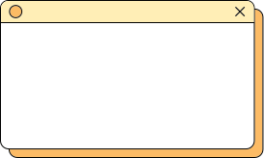
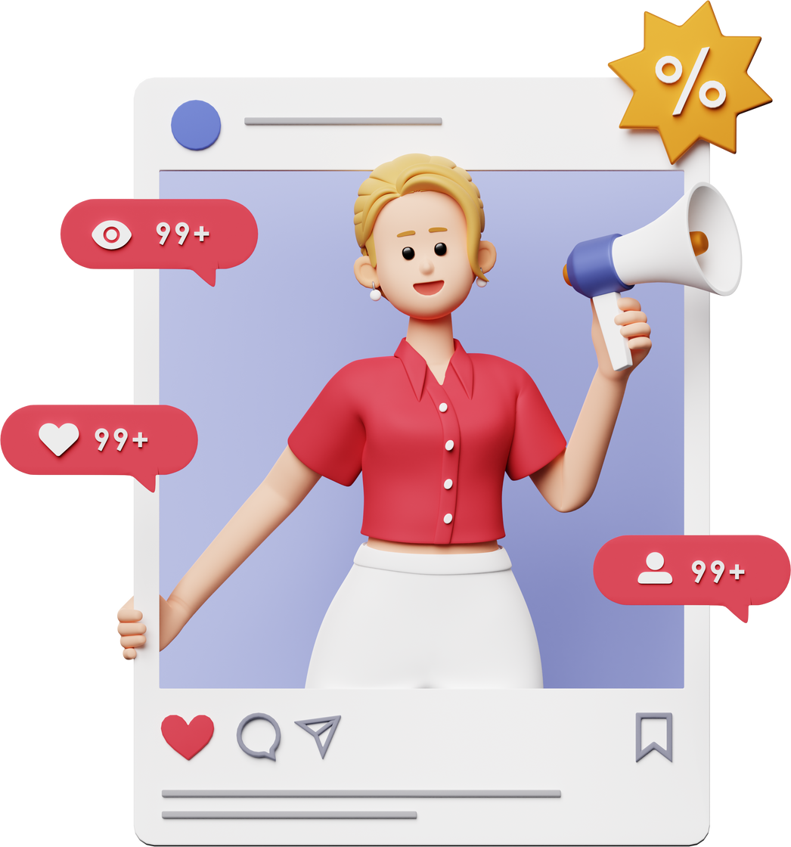


The Role of Gamification in Digital Marketing Strategies
MKTG 612 Marketing Analytics Project

Slide 2
-Divyasri Yelubolu
-Manasvini Edukulla
-Rishitha Thatipalli
-Srinidh Vudityala
-Anirudh Chaganty
-Rithika Pagadala
-Neeharika

Slide 3
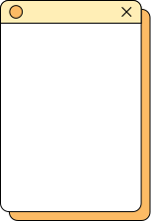

Agenda
Background
Research Objectives
Research Methodologies
Dendogram and Scree plot
Segmentation analysis
Spider and PCA Plot

Slide 4
Agenda
Actionable Insights
Strategies
Conclusion
Appendix
Thankyou

Slide 5
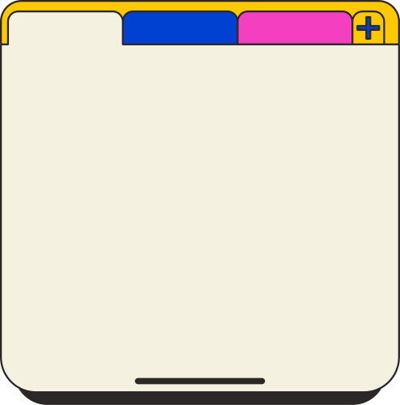
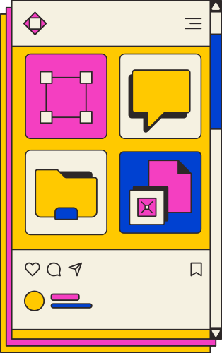
Background
Gamification involves integrating game elements (rewards, challenges, leaderboards) into marketing strategies to increase engagement.
Helps brands create interactive and memorable customer experiences.
Builds stronger emotional connections with users, leading to improved loyalty and retention.

Slide 6
Research Objectives
Primary Objective:
To understand how gamification strategies influence customer engagement and satisfaction.
Specific Objectives:
Segment customers based on their interaction with gamified campaigns.
Analyze gamification’s impact on purchase behavior and retention.
Provide actionable strategies for effective targeting and positioning.

Slide 7

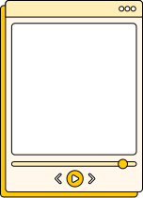


Research Methodology
1.
2.
3.
SURVEY DESIGN
SAMPLE DETAILS AND DATA ANALYSIS
LIMITATIONS:
Developed an online survey on Qualtrics to gather insights on gamification preferences.
Questions focused on:
Frequency of interaction with gamified features.
Motivators like rewards and challenges.
Overall impact on purchase intent and engagement.
Sample Size: 89 respondents.
Demographics: Mixed-age group and diverse familiarity with gamified campaigns.
Balanced distribution across professions, ensuring wide representation.
Data Analysis-
Used Enginius software for:
Hierarchical clustering to identify customer segments.
PCA analysis for data visualization.
Small sample size limits generalizability.
Potential self-reporting bias in survey responses.

Slide 8
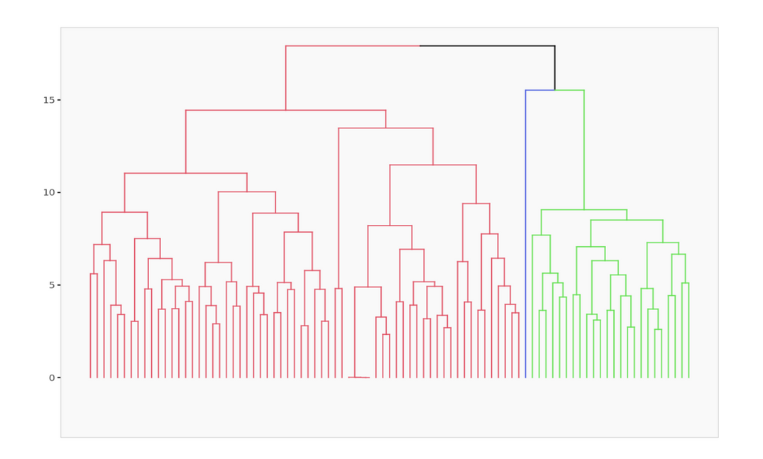
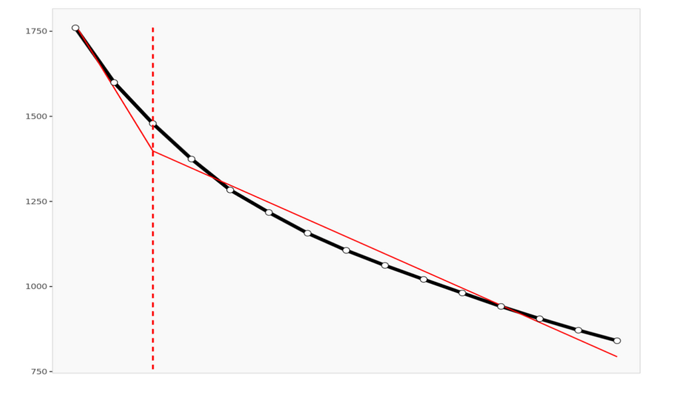
Dendogram
Scree plot

Slide 9

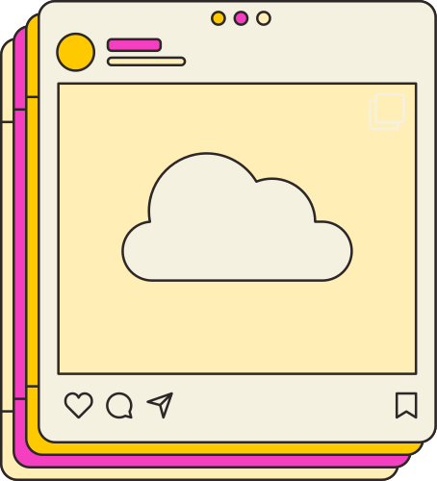
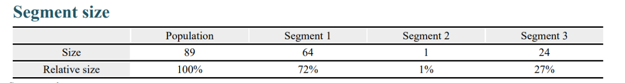
Findings – Segmentation Analysis
Customer Segments Identified
Casual Participants (72%):
Limited interaction with gamification features.
Motivated by straightforward, low-effort rewards.
Represent the largest group, requiring basic engagement strategies.
Engaged Enthusiasts (27%):
Highly engaged with gamified campaigns.
Strong preference for personalized experiences and advanced gamification elements.
Significant impact on purchase intent, making them a valuable target.
Outlier (1%):
Extremely engaged but negligible in size.

Slide 10
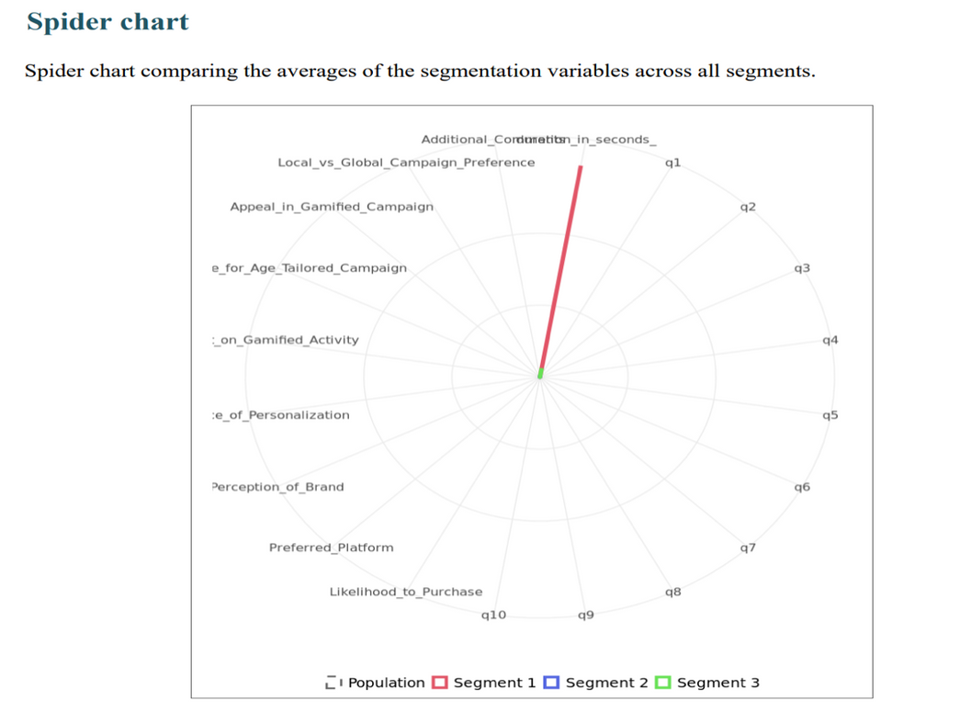
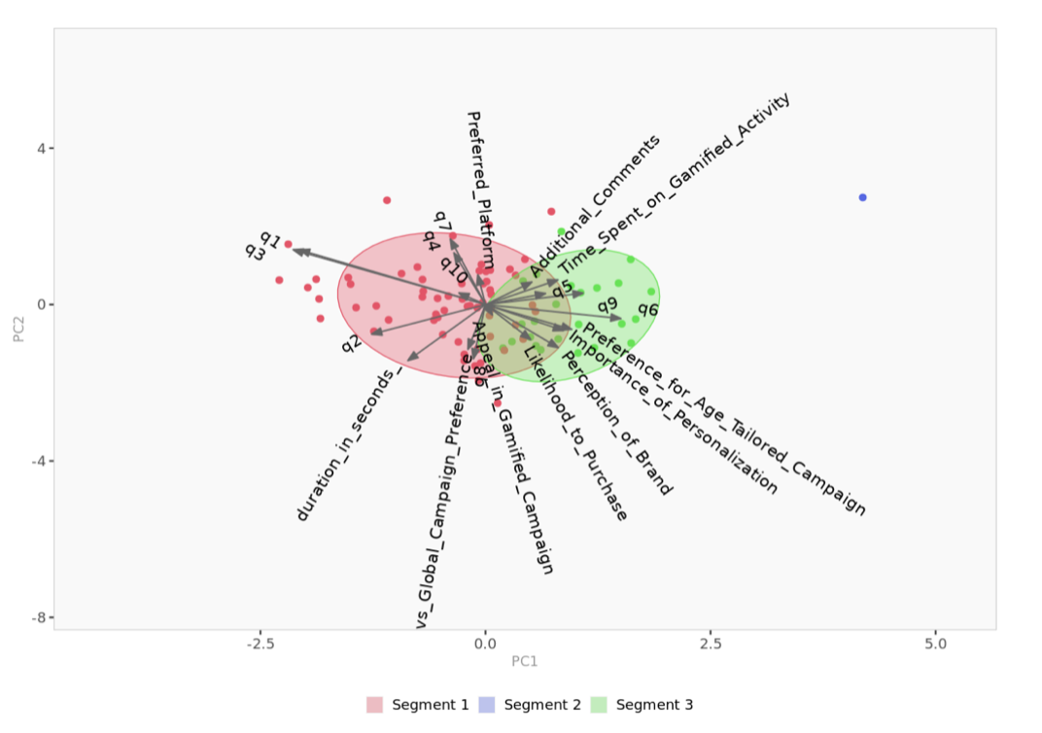
Spider chart and PCA Plot

Slide 11
Actionable Insights for Customer Satisfaction and Purchase Likelihood
Segment 3: Engaged Enthusiasts
Personalization boosts satisfaction and loyalty.
Advanced gamification (leaderboards, competitions) increases engagement and purchases.
Exclusive rewards drive repeat purchases.

Slide 12
Actionable Insights for Customer Satisfaction and Purchase Likelihood
Segment 1: Casual Participants
Simplified features (quizzes, instant rewards) increase participation.
Immediate incentives (discounts) influence behavior.
Mobile and social media-friendly campaigns reduce barriers.

Slide 13
Actionable Insights for Customer Satisfaction and Purchase Likelihood
Platform Insights
Focus on mobile apps and social media for maximum reach and convenience.

Slide 14
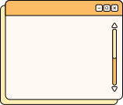

Strategies- Segment 3
Personalization Strategies for Engaged Enthusiasts (27%)
Behavioral Tracking
Track actions (e.g., challenges, rewards, log-ins) using analytics tools like Google Analytics.
Impact: Creates dynamic user profiles for evolving personalized experiences.
Recommendation Engines
Suggest tailored challenges based on past behaviors using machine learning algorithms.
Impact: Enhances satisfaction and boosts engagement.
CRM Integration
Combine gamification with CRM (e.g., Salesforce) for personalized messages based on demographics and purchases.
Impact: Delivers hyper-relevant experiences, driving loyalty and repeat sales.

Slide 15
Strategies-Segment 1
Key Strategies for Engagement of casual participants
Low-Friction Onboarding
Simplify interface with features like a “Play Now” button leading to instant rewards (e.g., scratch-off cards).
Impact: Reduces cognitive load and encourages spontaneous participation.
Mobile-First Integration
Optimize for mobile; enable Single-Sign-On via Facebook, Google, or Apple.
Impact: Ensures seamless engagement with minimal effort.
Automated Rewards System
Use a simple points system with instant redemption (e.g., “Complete a 30-second quiz, get 10% off”).
Impact: Offers immediate gratification, increasing repeat participation.

Slide 16
Strategies - Segment 2
Outlier(1%)
Monitor Behavior for Insights
Track responses to advanced features or exclusive events.
Purpose: Gather data on high engagement drivers without extensive investment.
Conduct Micro-Pilots
Test beta features or advanced options with this group.
Impact: Identify potential innovations to scale for larger segments, such as Segment 3.
Leverage Learnings for Future Strategies
Use insights to refine features or campaigns that might resonate with broader, more significant segments.
Value: Guides innovation and strategy development without large-scale commitment.

Slide 17
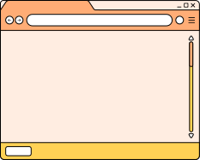

Conclusion
Insights:
Segment 3 (Engaged Enthusiasts) is the most valuable for advanced strategies.
Segment 1 (Casual Participants) requires simpler approaches for engagement.
Takeaways:
Gamification strategies should align with customer motivators and preferences.
Customer segmentation drives targeted marketing and improved ROI.

Slide 18
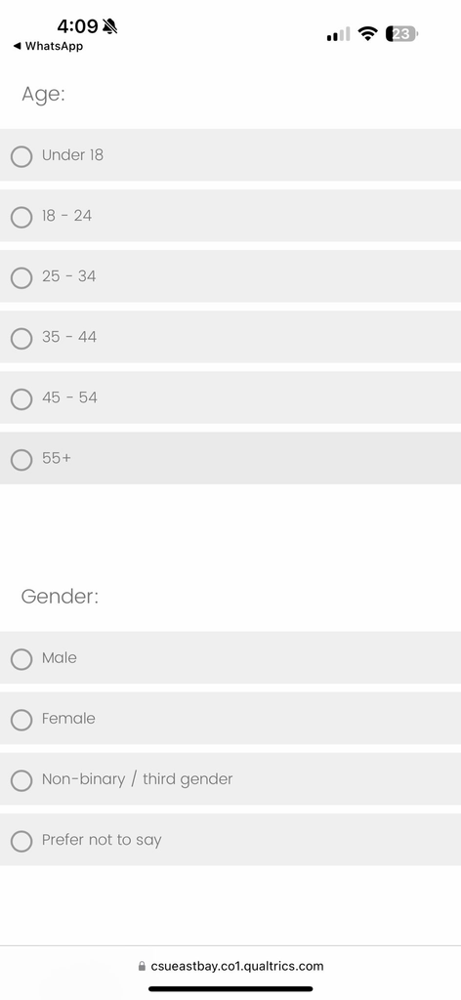
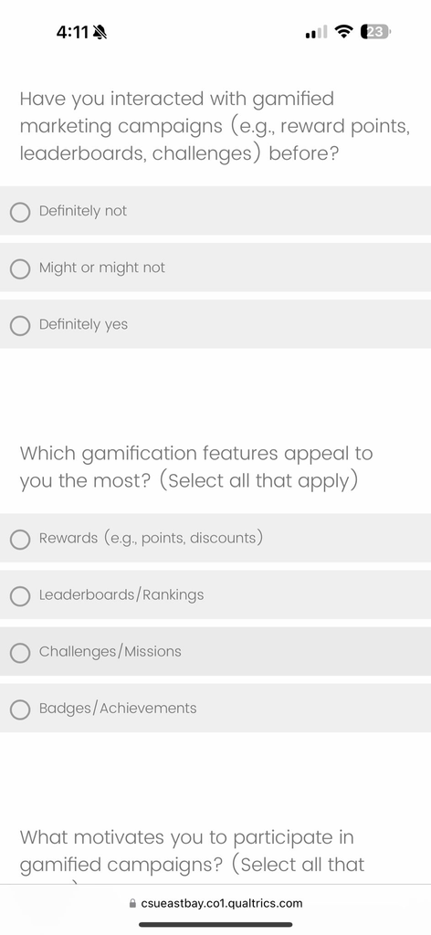
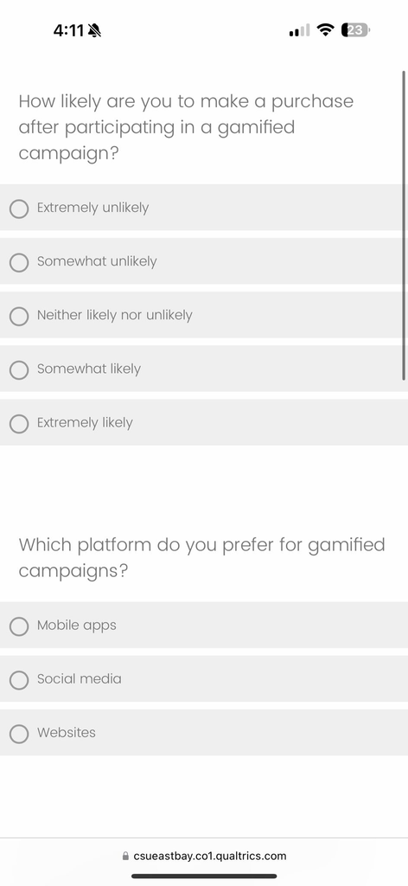
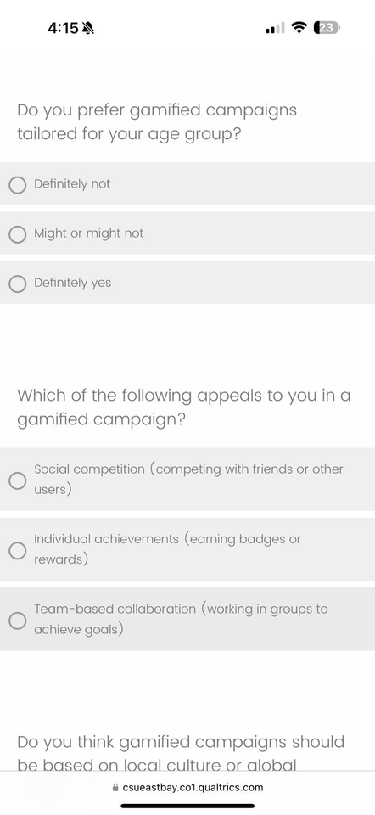
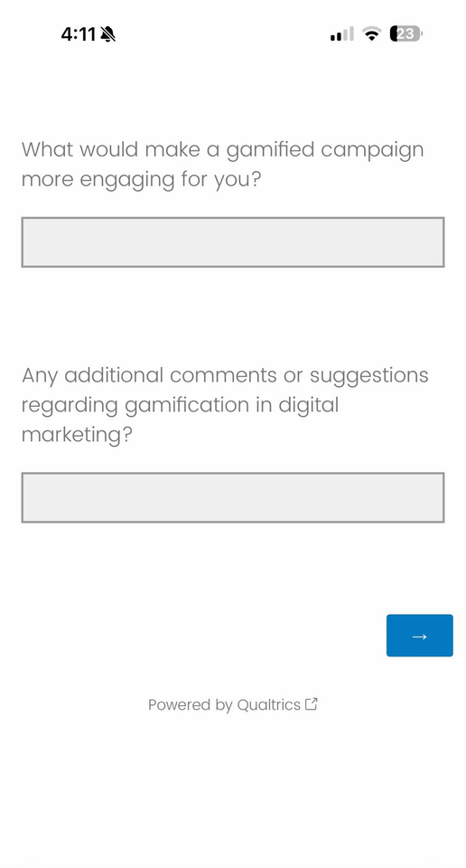
Appendix
Survey Questions

Slide 19
Thank You

